Slide 1
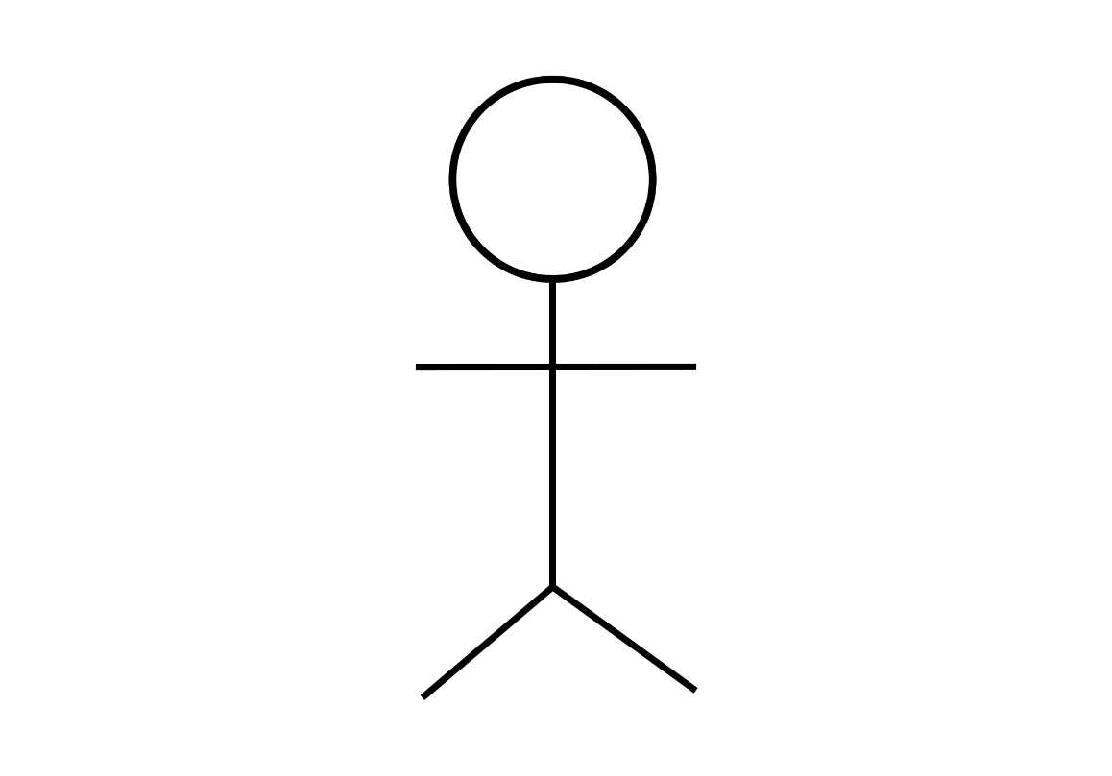
1st Module User Account Management
Register Details
<<extend>>
Perform Login
View Account Details
Staff
<<extend>>
Edit Account Details
End User
Add New Staff Account
Remove Staff Account
View Staff Account
Admin

